Slide 1






Consumer Goods Ad-Hoc Analysis

Slide 2

OBJECTIVE
Atliq Hardware (imaginary company) is one of the leading computer hardware producers in India and well expanded in other countries too.
Offers a range of products, including PCs, keyboards, mouse, processors, and motherboards.
The aim is to gain insights and inform strategic decision-making to optimize sales and maximize revenue.

Slide 3






TOOLS USED
PLATFORM
BRICK & MORTAR
E-COMMERCE

Slide 4

RETAILER
CHANNEL
DIRECT
E-Store
DISTRIBUTOR
FISCAL - YEAR
SEPTEMBER TO AUGUST

Slide 5
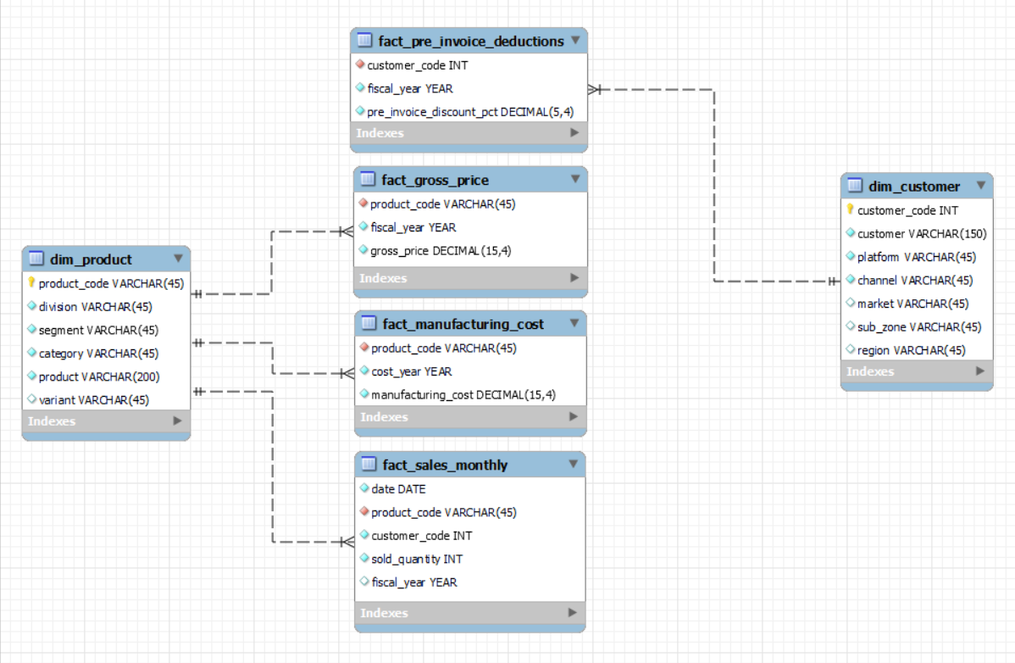
DATA MODEL

Slide 6
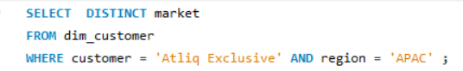



REQUEST 1
Provide the list of markets in which customer "Atliq Exclusive" operates its business in the APAC region.
SQL QUERY

Slide 7
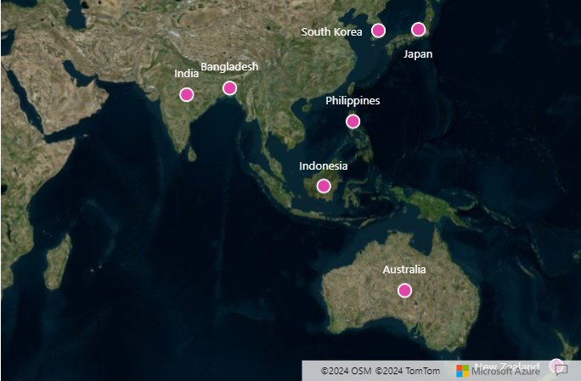
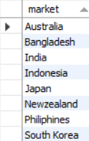
OUTPUT
Atliq Exclusive operates its business in several key markets within the APAC region
Australia, Bangladesh, India, Japan, South Korea, Philippines, New Zealand, and Indonesia.
By leveraging its existing foothold in these APAC markets and implementing targeted strategies, Atliq Exclusive can strengthen its position and drive growth within the region.

Slide 8
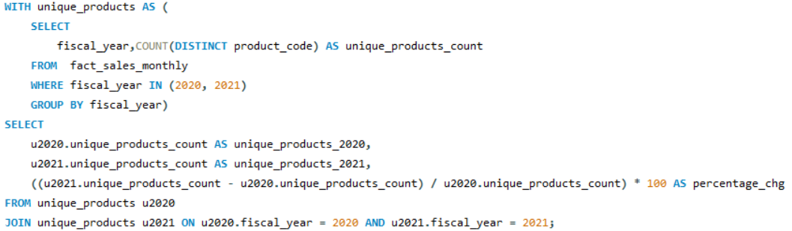
REQUEST 2
What is the percentage of unique product increase in 2021 vs. 2020?
SQL QUERY

Slide 9
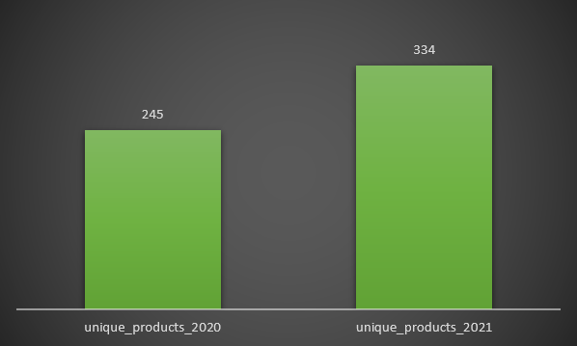
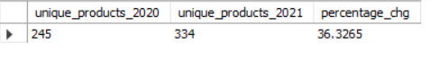
OUTPUT
In 2021, Atliq Hardware produced 334 unique products, compared to 2020.
This represents a significant increase of 36.32% in the number of products manufactured from the previous year.

Slide 10
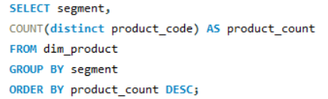
REQUEST 3
Provide a report with all the unique product counts for each segment and sort them in descending order of product counts.
SQL QUERY

Slide 11
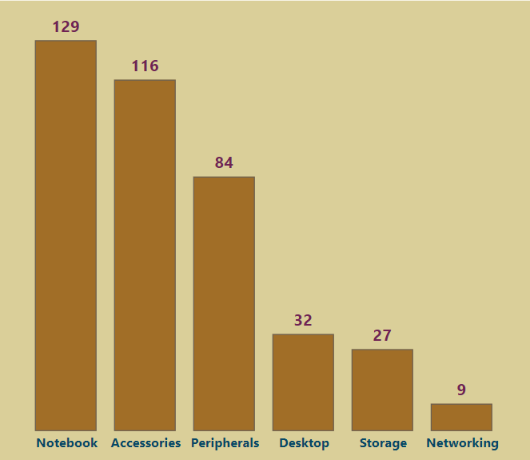
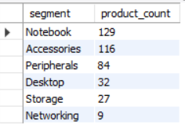
OUTPUT
Atliq Hardware offers products across six segments, Notebooks, Accessories, Peripherals, Desktop, Storage and Networking.
Among these, Notebooks have the highest product count, while Networking has the lowest.

Slide 12
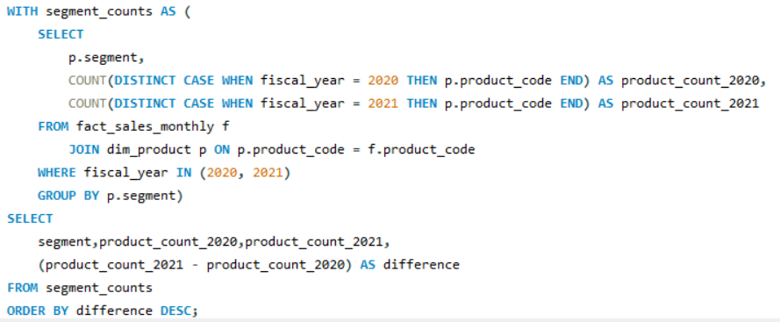
REQUEST 4
Which segment had the most increase in unique products in 2021 vs 2020?
SQL QUERY

Slide 13
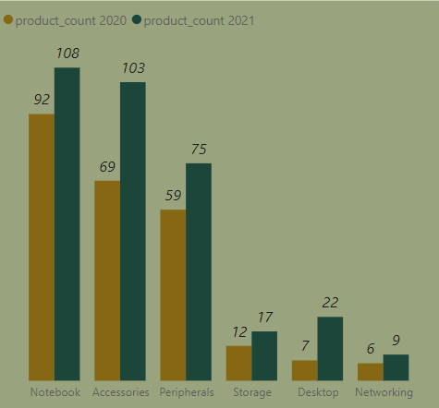
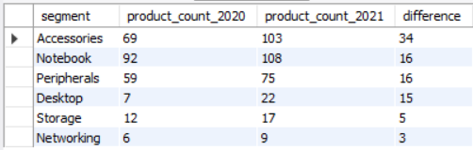
OUTPUT
In 2021, Atliq Hardware saw the largest increase in the accessories segment, adding a total of 34 new products.
This surge in product offerings reflects the strong demand for accessories.
Despite adding new products across all segments, networking experienced the lowest increment with only 3 new products introduced.

Slide 14
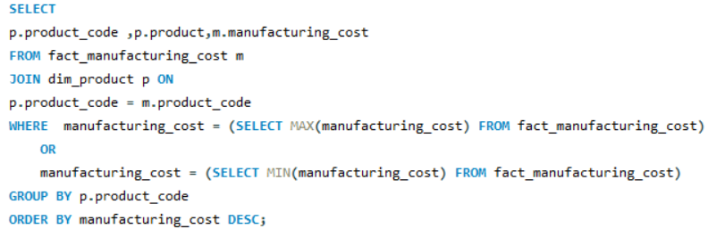
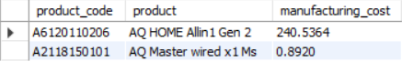
REQUEST 5
Get the products that have the highest and lowest manufacturing costs.
SQL QUERY
OUTPUT

Slide 15
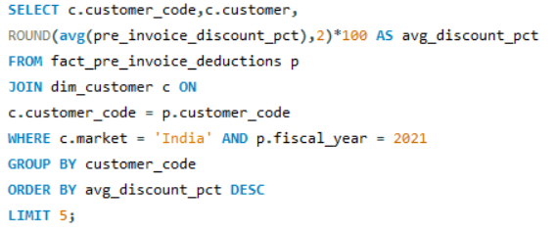
REQUEST 6
Generate a report which contains the top 5 customers who received an average high pre_invoice_discount_pct for the fiscal year 2021 and in the Indian market.
SQL QUERY

Slide 16
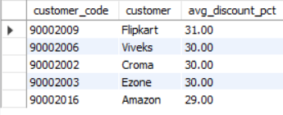
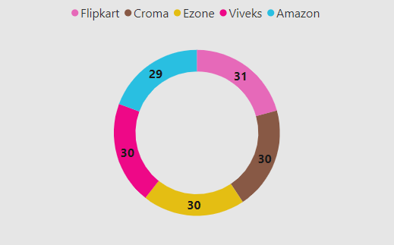
OUTPUT

Slide 17
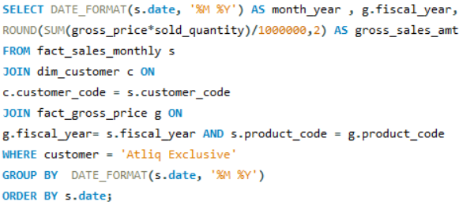
REQUEST 7
Get the complete report of the Gross sales amount for the customer “Atliq Exclusive” for each month .
SQL QUERY

Slide 18
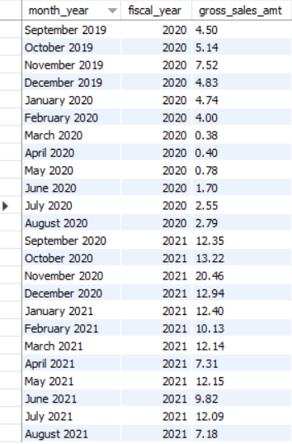
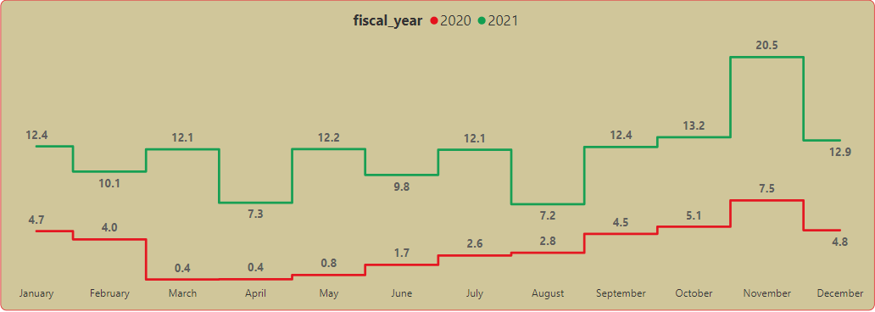
OUTPUT
Atliq Exclusive experienced fluctuations in gross sales throughout fiscal year 2020, starting at 4.5 million and reaching a low of 0.38 million in March, possibly due to the COVID-19 pandemic.
There was a significant surge in sales during fiscal year 2021, peaking at 20.46 million in November 2020.

Slide 19
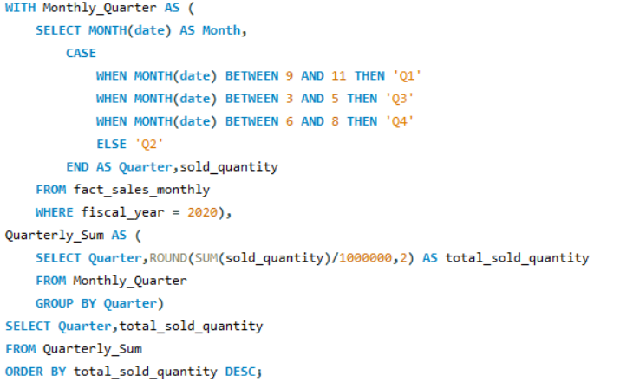
REQUEST 8
In which quarter of 2020, got the maximum total_sold_quantity?
SQL QUERY

Slide 20
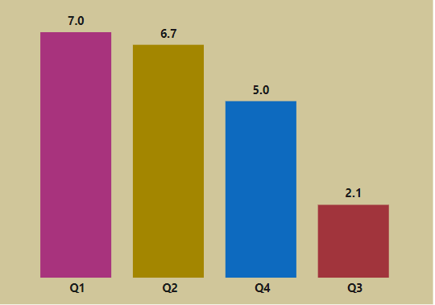
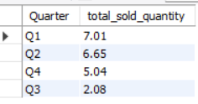
OUTPUT
Atliq Hardware experienced its highest total sold quantity in Quarter 1 (September, October, November) of 2020,
while Quarter 3 (March, April, May) saw a notable decrease in sold quantity.

Slide 21
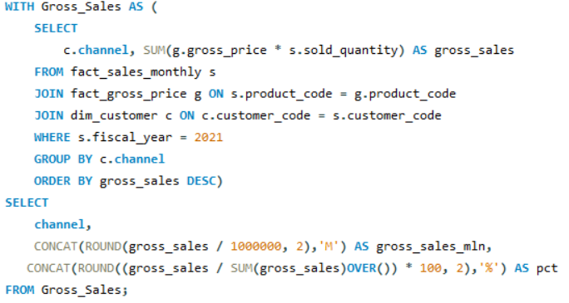
REQUEST 9
Which channel helped to bring more gross sales in the fiscal year 2021 and the percentage of contribution?
SQL QUERY

Slide 22
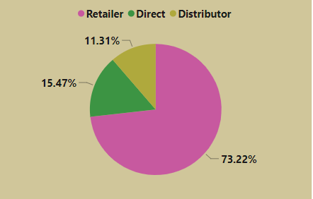
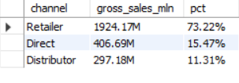
OUTPUT
In fiscal year 2021,
Retailer channel generated the highest gross sales of 1924.17 million,
While the Distributor channel contributed the least of 297.18 million.

Slide 23
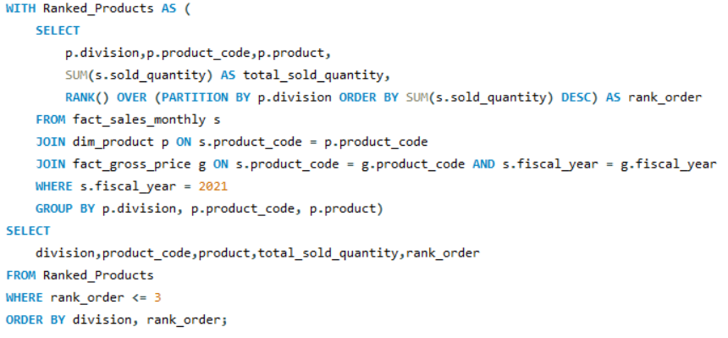
REQUEST 10
Get the Top 3 products in each division that have a high total_sold_quantity in the fiscal_year 2021?
SQL QUERY

Slide 24
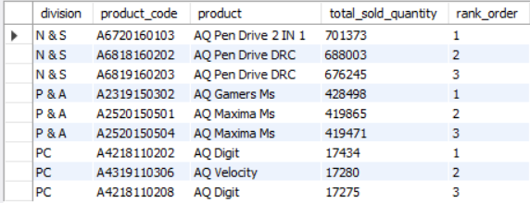
OUTPUT

Slide 25

THANK YOU

